Slide 1
Data Analytics with Tableau
.

Slide 2
Introduction to Internship
The internship was part of APSCHE–SmartBridge collaboration focused on providing real-time, industry-oriented learning.
The main objective was to gain hands-on experience in Data Analytics and Visualization using Tableau.

Slide 3
Learning Objectives
Gain practical experience in Data Analytics
Build interactive dashboards using Tableau
Learn data cleaning and visualization
Understand consumer insights and storytelling
Develop presentation and analytical skills

Slide 4
Organization Overview
APSCHE–SmartBridge partnership offers students practical exposure to technologies like Data Analytics, AI, and Cloud Computing.
Vision: To empower students with practical technology skills.
Mission: To bridge academia and industry through experiential learning.

Slide 5
Project:VISULATION TOOL FOR ELECTRIC VEHICLE CHARGE AND RANGE ANALYSIS
Objective: To analyze electrical vehicle sales.
Dataset:Indian elecricalVehicles.csv
Tools: Tableau, Excel, Google Sheets, MySQL
Outcome: Created dashboards showing insights into product sales performance.

Slide 6
Tools & Technologies Used
Tableau – Visualization and dashboard creation
MySQL – Data querying
Microsoft Excel – Data cleaning
Google Sheets – Preprocessing
GitHub – Project repository management

Slide 7
Weekly Activities Summary
Week 1–2: Learned data analytics basics and SQL operations
Week 3–4: Built dashboards and explored Tableau features
Week 5–6: Applied storytelling and created project dashboards
Week 7–8: Completed documentation, GitHub upload, and final evaluation

Slide 8
Skills Acquired
Technical Skills:
Tableau dashboard design
SQL querying and data cleaning
Data storytelling and visualization
Soft Skills:
Communication and teamwork
Problem-solving and time management

Slide 9
Internship Outcomes
Learned to interpret business data effectively
Developed analytical thinking
Understood visualization for decision-making
Improved technical and managerial competencies

Slide 10
Work Environment & Experience
The internship provided a supportive virtual learning environment with mentor guidance.
Collaboration, self-learning, and feedback were integral parts, enhancing professional confidence.

Slide 11
Conclusion
The internship enhanced both technical and professional skills in Data Analytics.
It strengthened my understanding of visualization and prepared me for real-world data-driven roles.

Slide 12
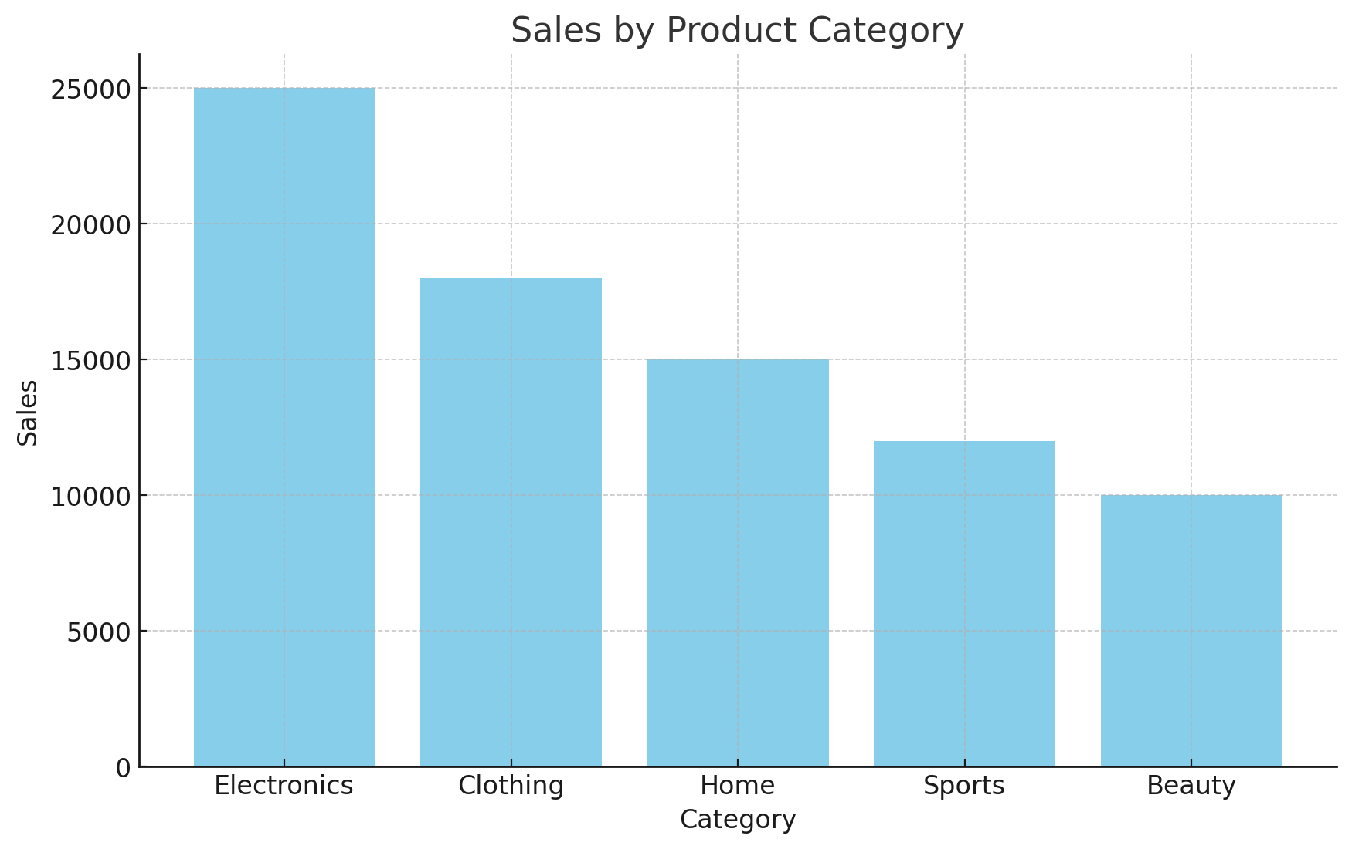
Sales by vehicles Category

Slide 13
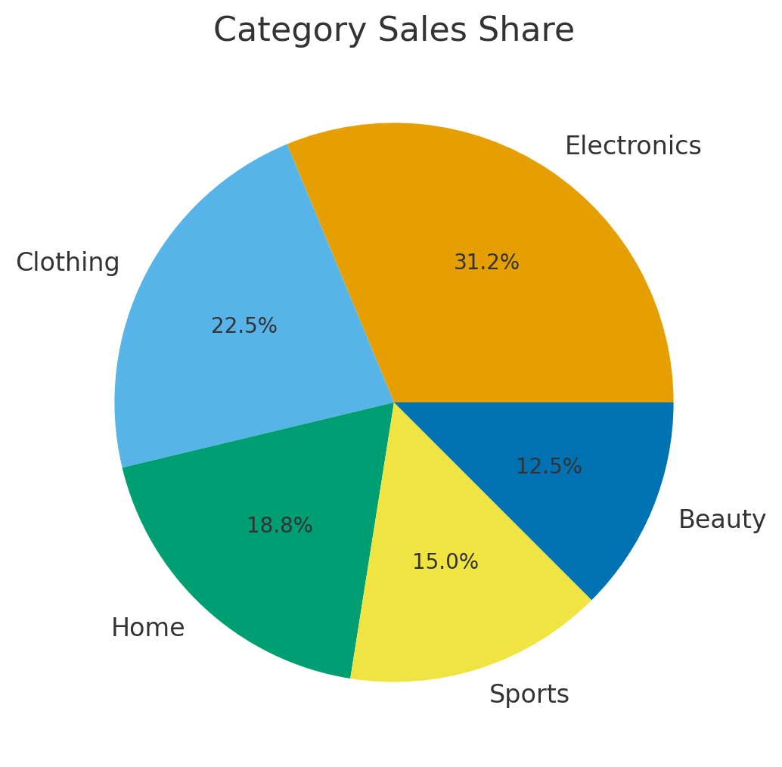
Category Sales Share

Slide 14
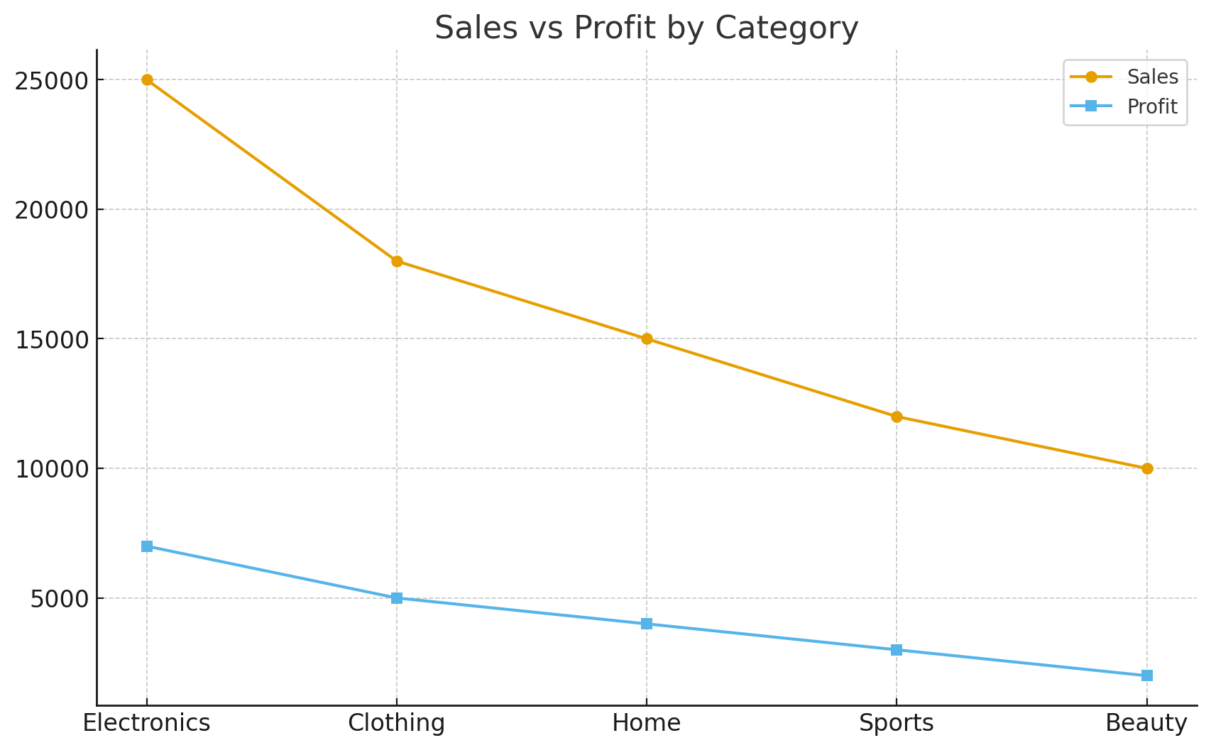
Sales vs Profit

Slide 15
THANK YOU
.

